Slide 1

Case Study
Attrition Analysis
Key Findings & Recommendations
Made by: Karim .A
September 2026

Slide 2

Problem Statement
Approach
total company attrition stands at 16.12% (237 of 1,470 employees), data on which roles, working conditions or tenure stages , etc. that actually drive that number can be used to assist with retention budget allocation.
HR efforts at retention can risk getting spread across the workforce instead of targeting segments where it will have the most impact.
Exploratory Data Analysis
Identifying attrition outliers and core trends across roles.
01
Star Schema Model
Modeling the database.
02
1,470
TOTAL EMPLOYEES
237
DEPARTED EMPLOYEES
03
DAX Measures Development
Calculating Attrition Rate, Average Tenure, Current Employees, Departed Employees, Total Employees
And Overtime %.
16.12%
ATTRITION RATE
7 yrs
AVERAGE TENURE
Interactive Power BI Dashboard
Providing interactive visual tools for decision-making.
04

Slide 3
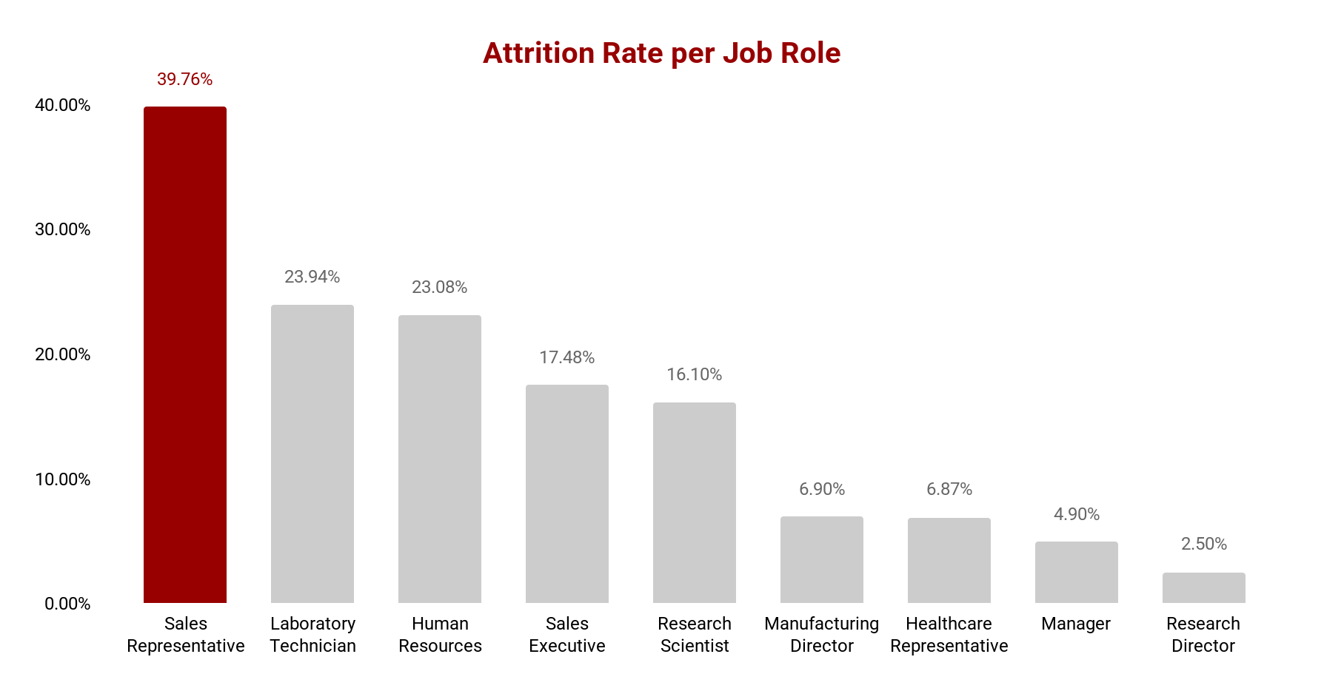
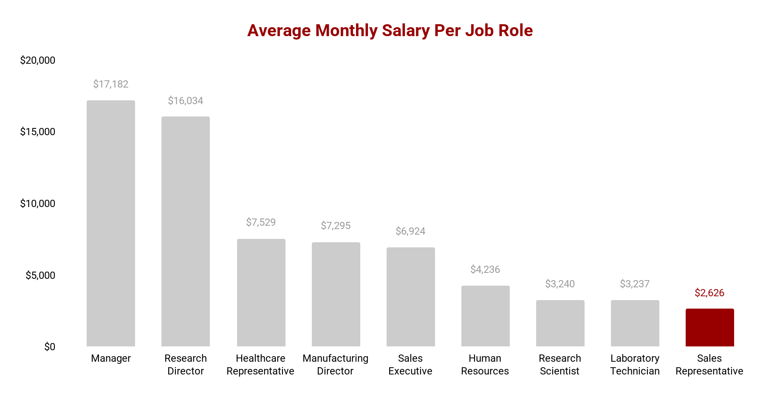
Key Findings
Biggest Driver:
Attrition Rate of Sales Representatives
The Sales Representative role is a massive outlier with an attrition rate of nearly 40% (39.76%), it is followed by Laboratory Technicians (23.94%) and Human Resources roles (23.08%) which also experience higher-than-average turnover. On the other hand, senior roles like Research Directors (2.50%) and Managers (4.90%) have the lowest attrition rates.
Attrition rate of Sales Representatives is a true statistical outlier with z-score of 2.0.
Sales Representatives have a Job Satisfaction of 2.73, almost equalling the total average across all job roles, indicating Job Satisfaction is not a primary driver of high turnover of Sales Representatives.
Average Monthly Salary between job roles experience a strong negative correlation with attrition rate (correlation coefficient of -0.76), with higher salaries seeing lower attrition rates, Sales Representatives have the lowest salary across all job roles, suggesting that Monthly Salary could be a primary driver for the high turnover of Sales Representatives

Slide 4
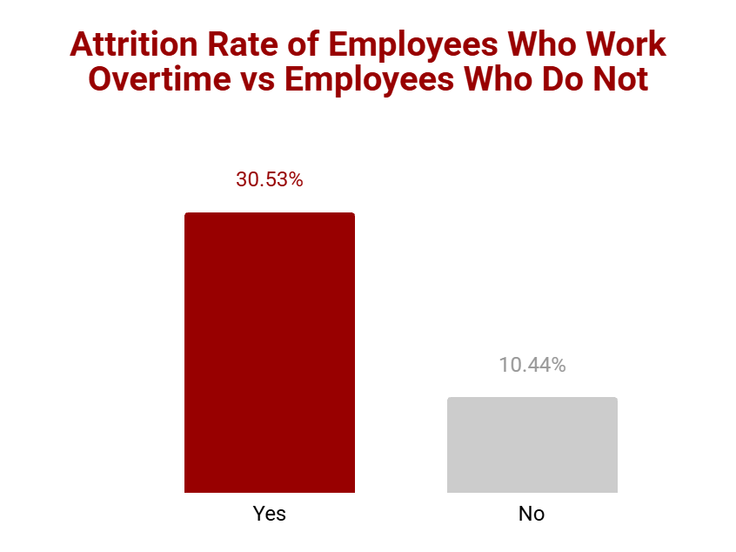
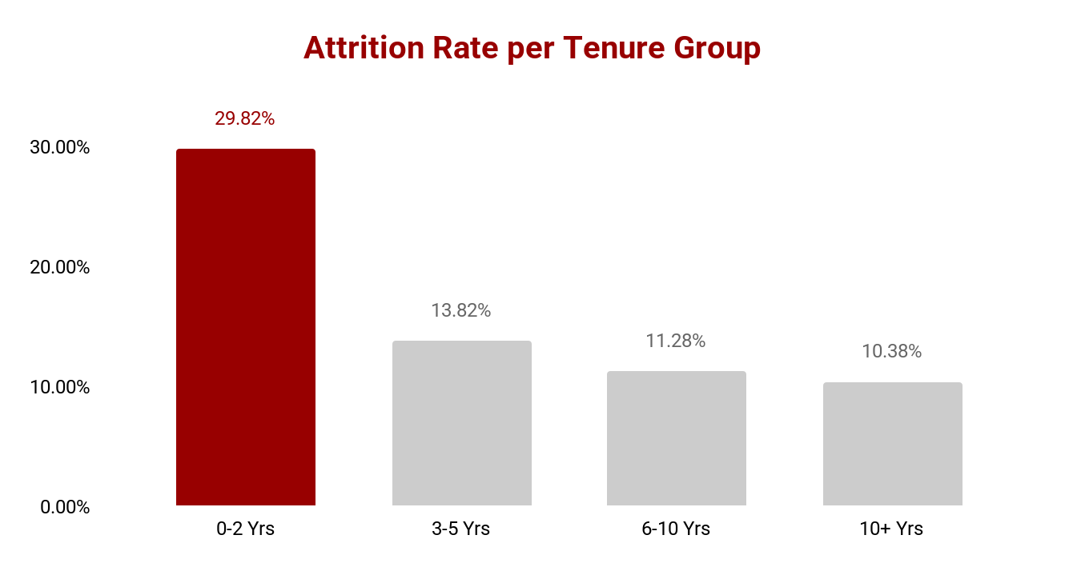
Key Findings
Overtime
Employees who work overtime (30.53% attrition rate) are 2.9 times more likely to leave compared to those who do not (10.44%).
Early Tenure Employees
Attrition is front-loaded, with an attrition rate of 29.82% in an employee's first 0–2 years, steadily declining to 10.38% for the 10+ years tenure group.
Frequency of Business Travel
Risk of attrition rises consistently with travel frequency, sitting at 24.91% for frequent travelers, 14.96% for rare travelers, and 8.00% for non-travelers.

Slide 5
Recommendations
Sales Representative outlier
Highest
Overtime
High
Review monthly salary for Sales Representatives and build a structured promotion path so employees see a career growth path before they enter the 3-5 years tenure group.
Check the distribution of workload in teams which contribute a lot of overtime hours, and check the possibility of balancing workload with employees who do not contribute overtime hours.
Early tenure (0–2 yrs)
Medium
Frequent travel
Medium
Review current onboarding process, ensure that new hires have sufficient support and mentorship to get them through the highest risk of attrition window.
Assess the travel demands of employees who frequently travel and check opportunities for reducing the need to travel for frequent travelers.

Slide 6
Recommendations For Further Analysis
Date-Based Trend Analysis
The inclusion of a date of attrition and date of join fields can allow for date-based trend analysis, identifying seasonality in attrition, if it exists, and correlating events with spikes in attrition.
Predictive Modeling
Data can be explored further to produce predictive models, fields such as Job Satisfaction, education level, and work-life balance can potentially be of great use being used as predictors for predictive machine learning models.

Slide 7
Thank You
HR Attrition & Retention Analysis

